Slide 1

Meta-analysis of prognostic studies
Thomas Debray, PhD

Slide 2

Numerous models for same target population + outcomes
$>$ 300 models for predicting cardiovascular disease
$>$ 100 models for brain trauma patients
$>$ 100 diabetes type 2 models
$>$ 60 models for breast cancer prognosis

Slide 3
Need for systematic reviews
Abundance of CPMs, with poor understanding of
The comparative performance of these CPMs
The consistency of effects and risk estimates across CPMs
The clinical impact of these CPMs
Systematic review of validation studies may help to identify promising models and evaluate the need for further improvements.

Slide 4
Why do we need meta-analysis?
Quantitative synthesis (meta-analysis) may help
To summarize the predictive performance of a CPM
To evaluate whether a CPM yields consistently good performance across different populations, outcomes etc
To identify possible improvements of CPMs
To establish boundaries of applicability and generalizability

Slide 6
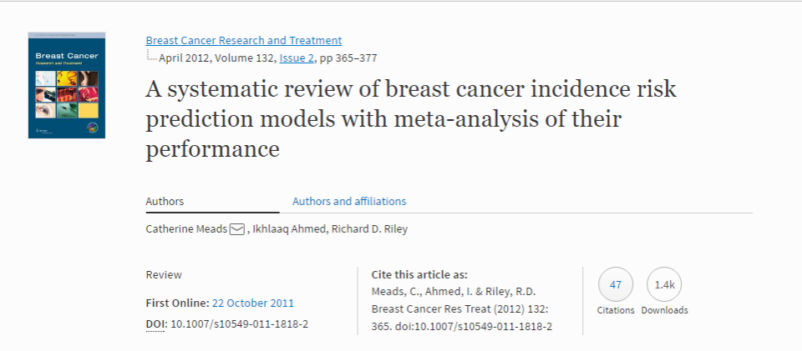
Is it even possible?

Slide 7
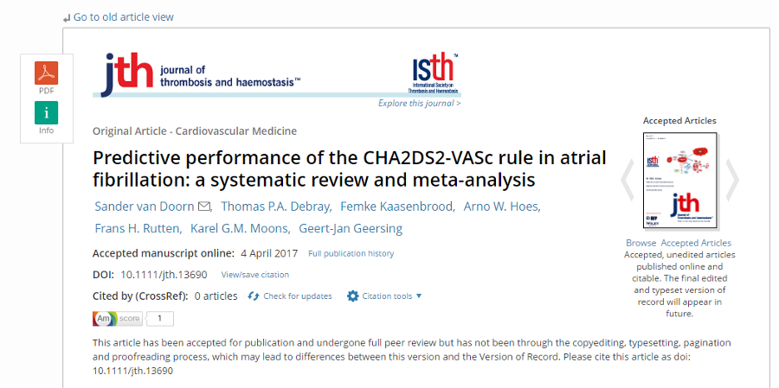
Is it even possible?

Slide 8
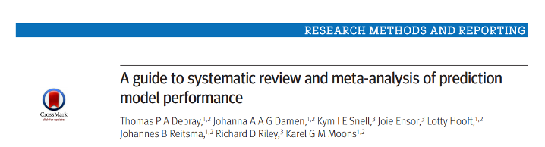
Guidance paper
Ref: https://doi.org/10.1136/bmj.i6460

Slide 9
Required steps of the meta-analysis
Well formulated systematic review question
Extensive search
Selection & data extraction
Critical appraisal
Data synthesis Pooling of CPM performance
Interpretation of results Confidence & prediction intervals, meta-regression, subgroup analysis, sensitivity analyses

Slide 10
Data extraction

Slide 11
Recap: what are validation studies?
Apply the CPM to new individuals
Internal validation
Temporal validation
Geographical validation
Domain validation
Evaluate the predictive accuracy
Overall performance
Calibration
Discrimination

Slide 12
Discrimination
Quantifies the model’s extent to distinguish between events and non-events
Visual inspection
Receiving Operating Characteristics (ROC) curve
Summary statistics
Concordance (c) index
Area under the ROC curve (AUC)
Discrimination slope

Slide 13
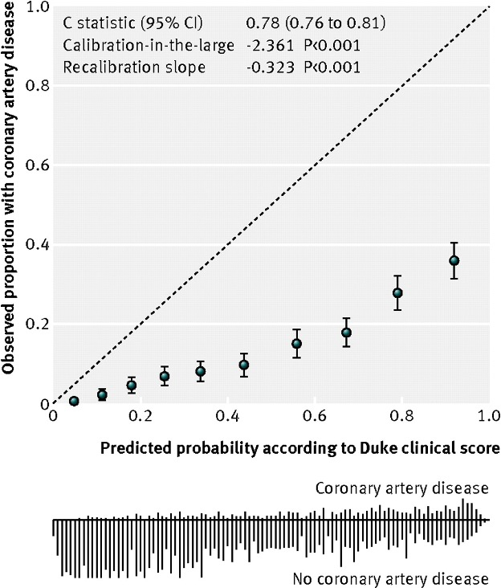
Calibration
Agreement between observed outcomes and predictions
Ref: Genders et al. Prediction model to estimate presence of coronary artery disease: retrospective pooled analysis of existing cohorts. BMJ 2012

Slide 14
How to obtain the c-statistic?
Area under the receiver operating characteristic curve
Somer’s D statistic
Cohen’s effect size
Distribution of the prognostic index (PI)
Log odds ratio of the PI
The SE can be derived from
Confidence interval
Sample size, total #events and c-statistic

Slide 15
How to obtain the total O:E ratio?
Total number of patients
Total number or proportion of observed events
Total number or proportion of predicted events
Predicted risk for the “average” patient
The SE can be derived from the total number of observed and expected events.

Slide 16
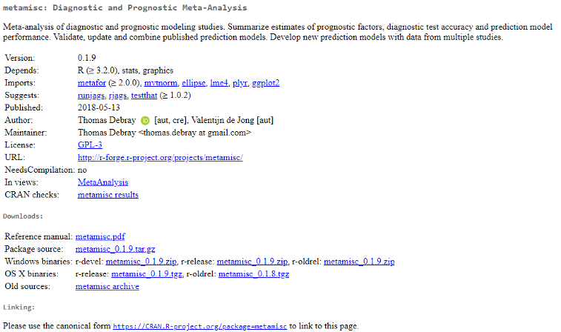
Software
The metamisc R package

Slide 17
Software
The metamisc R package
Estimation of performance statistics and corresponding standard errors from reported quantities
Transformation of performance estimates and corresponding standard errors
Meta-analysis & meta-regression
Frequentist (via metafor)
Bayesian (via JAGS)
Visualization of results
https://CRAN.R-project.org/package=metamisc

Slide 18
Meta-analysis of validation studies

Slide 19
Fixed effect or random effects?
Homogeneous model performance often unrealistic
Model discrimination varies according to case-mix heterogeneity (e.g. primary vs. secondary care)
Model calibration varies according to outcome occurrence
Model performance may vary due to covariates not included by the model
Model performance may vary due to differences in study design
Model performance may vary due to differences in treatment standards

Slide 20
Fixed effect or random effects?
Homogeneous model performance often unrealistic
Heterogeneity in the predictive performance of a CPM is to be expected!
Ignoring such heterogeneity leads to an overly precise summary estimate
Pooled estimates of model performance have little value when there is strong heterogeneity

Slide 21
Fixed effect or random effects?
Traditional meta-analysis methods approximate within-study variability with a Normal distribution
This approximation may introduce bias or show other poor statistical properties when
The c-statistic or O:E ratio is close to 0 or 1
When sample sizes are relatively small
Need for transformations!
Meta-analysis of logit c-statistic
Meta-analysis of log O:E ratio

Slide 22
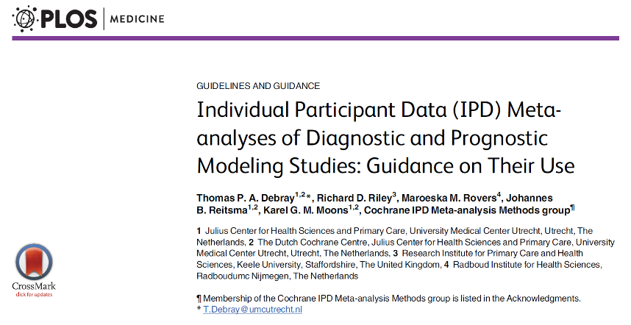
Use of appropriate meta-analysis methods
Individual participant data (IPD) meta-analysis

Slide 23
Investigating heterogeneity
Meta-regression
Adjust the meta-analysis for study-level variables such as:
Study characteristics
Study design
Follow-up time
Predictor- and outcome definitions
Cut-point for dichotomizing prognostic factor

Slide 24
Investigating heterogeneity
Meta-regression
Population characteristics
Mean of linear predictor or individual covariates
SD of linear predictor or individual covariates
Treatment standards (beware of ecological fallacy)
Ref: Berlin et al. Individual patient- versus group-level data meta-regressions of treatment effect modifiers: ecological bias rears its ugly head. Stat Med 2002.

Slide 25
Investigating heterogeneity
Sensitivity analysis
Exclude studies of questionable quality (cfr. PROBAST)
Risk of bias
Participant selection
Predictors
Outcome
Sample size and participant flow
Analysis

Slide 26
Investigating heterogeneity
Sensitivity analysis
Applicability
Participant selection
Predictors
Outcome

Slide 27
Interpretation of meta-analysis results
Describe model generalizability
Evaluate model robustness when applied in new populations
Pooled estimate and 95% CI
Prediction interval
Identify populations where model performance is satisfactory and others where it is inadequate

